Slide 1


CERTA Certification Course

Slide 2
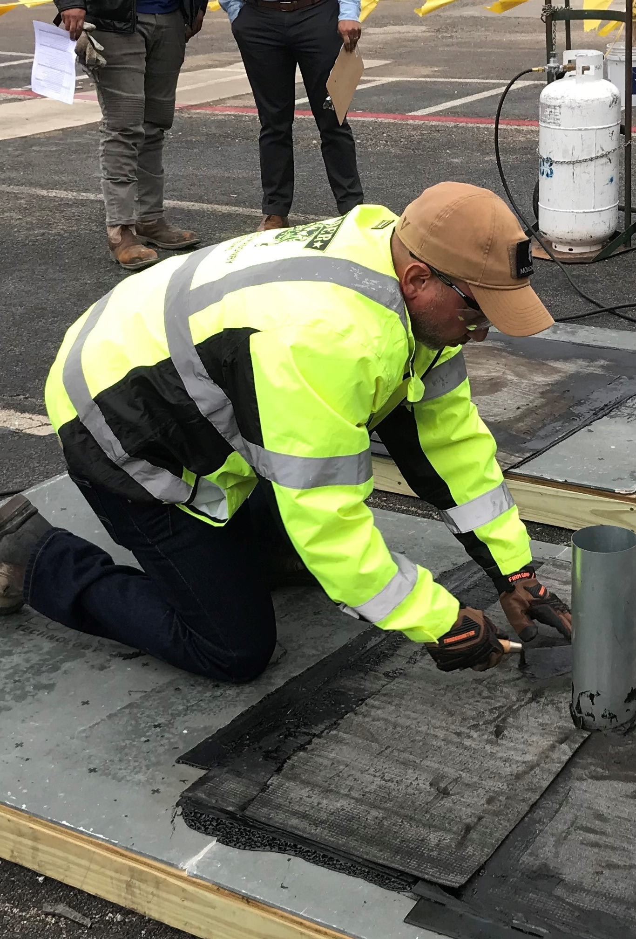
Course flow
Introduction
General Requirements
Pre-job Planning and Preparation
Propane Tool and Equipment Safety
Application Safety
Post-job Requirements and Duties
Hands-on Torching
Exam

Slide 3
Certa safety practices
Checklist
Pre-job Planning
Application
Torching Safety
Fire Watch Requirements

Slide 4
General requirements
Section 1

Slide 5
During this section you should be able to:
1. List personal protective equipment requirements for torching activities
2. Describe basic first-aid procedures associated with torching activities
3. Describe the PASS system for using a fire extinguisher

Slide 6
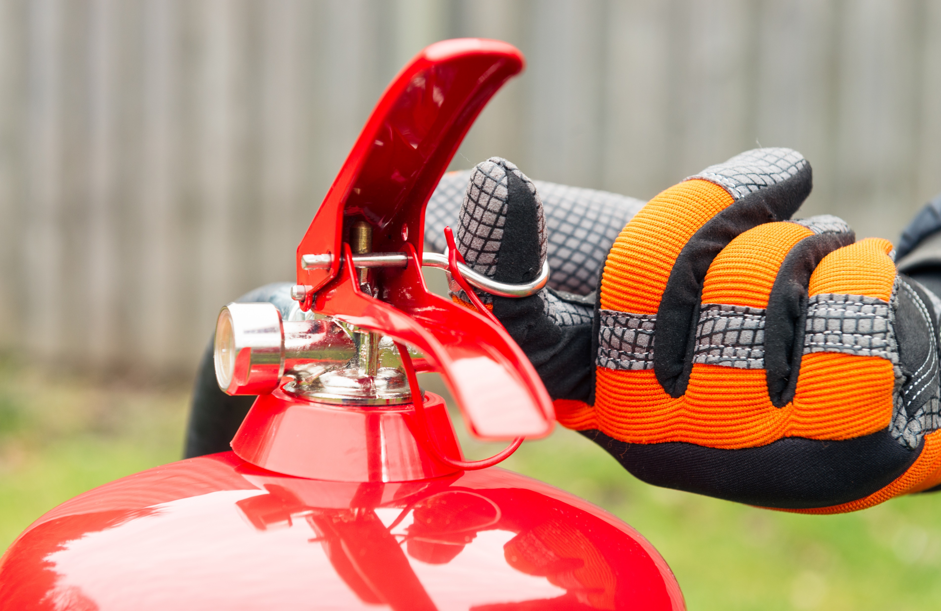
pull
Pull out the ring pin while holding the fire extinguisher upright. This will snap the safety seal.

Slide 7
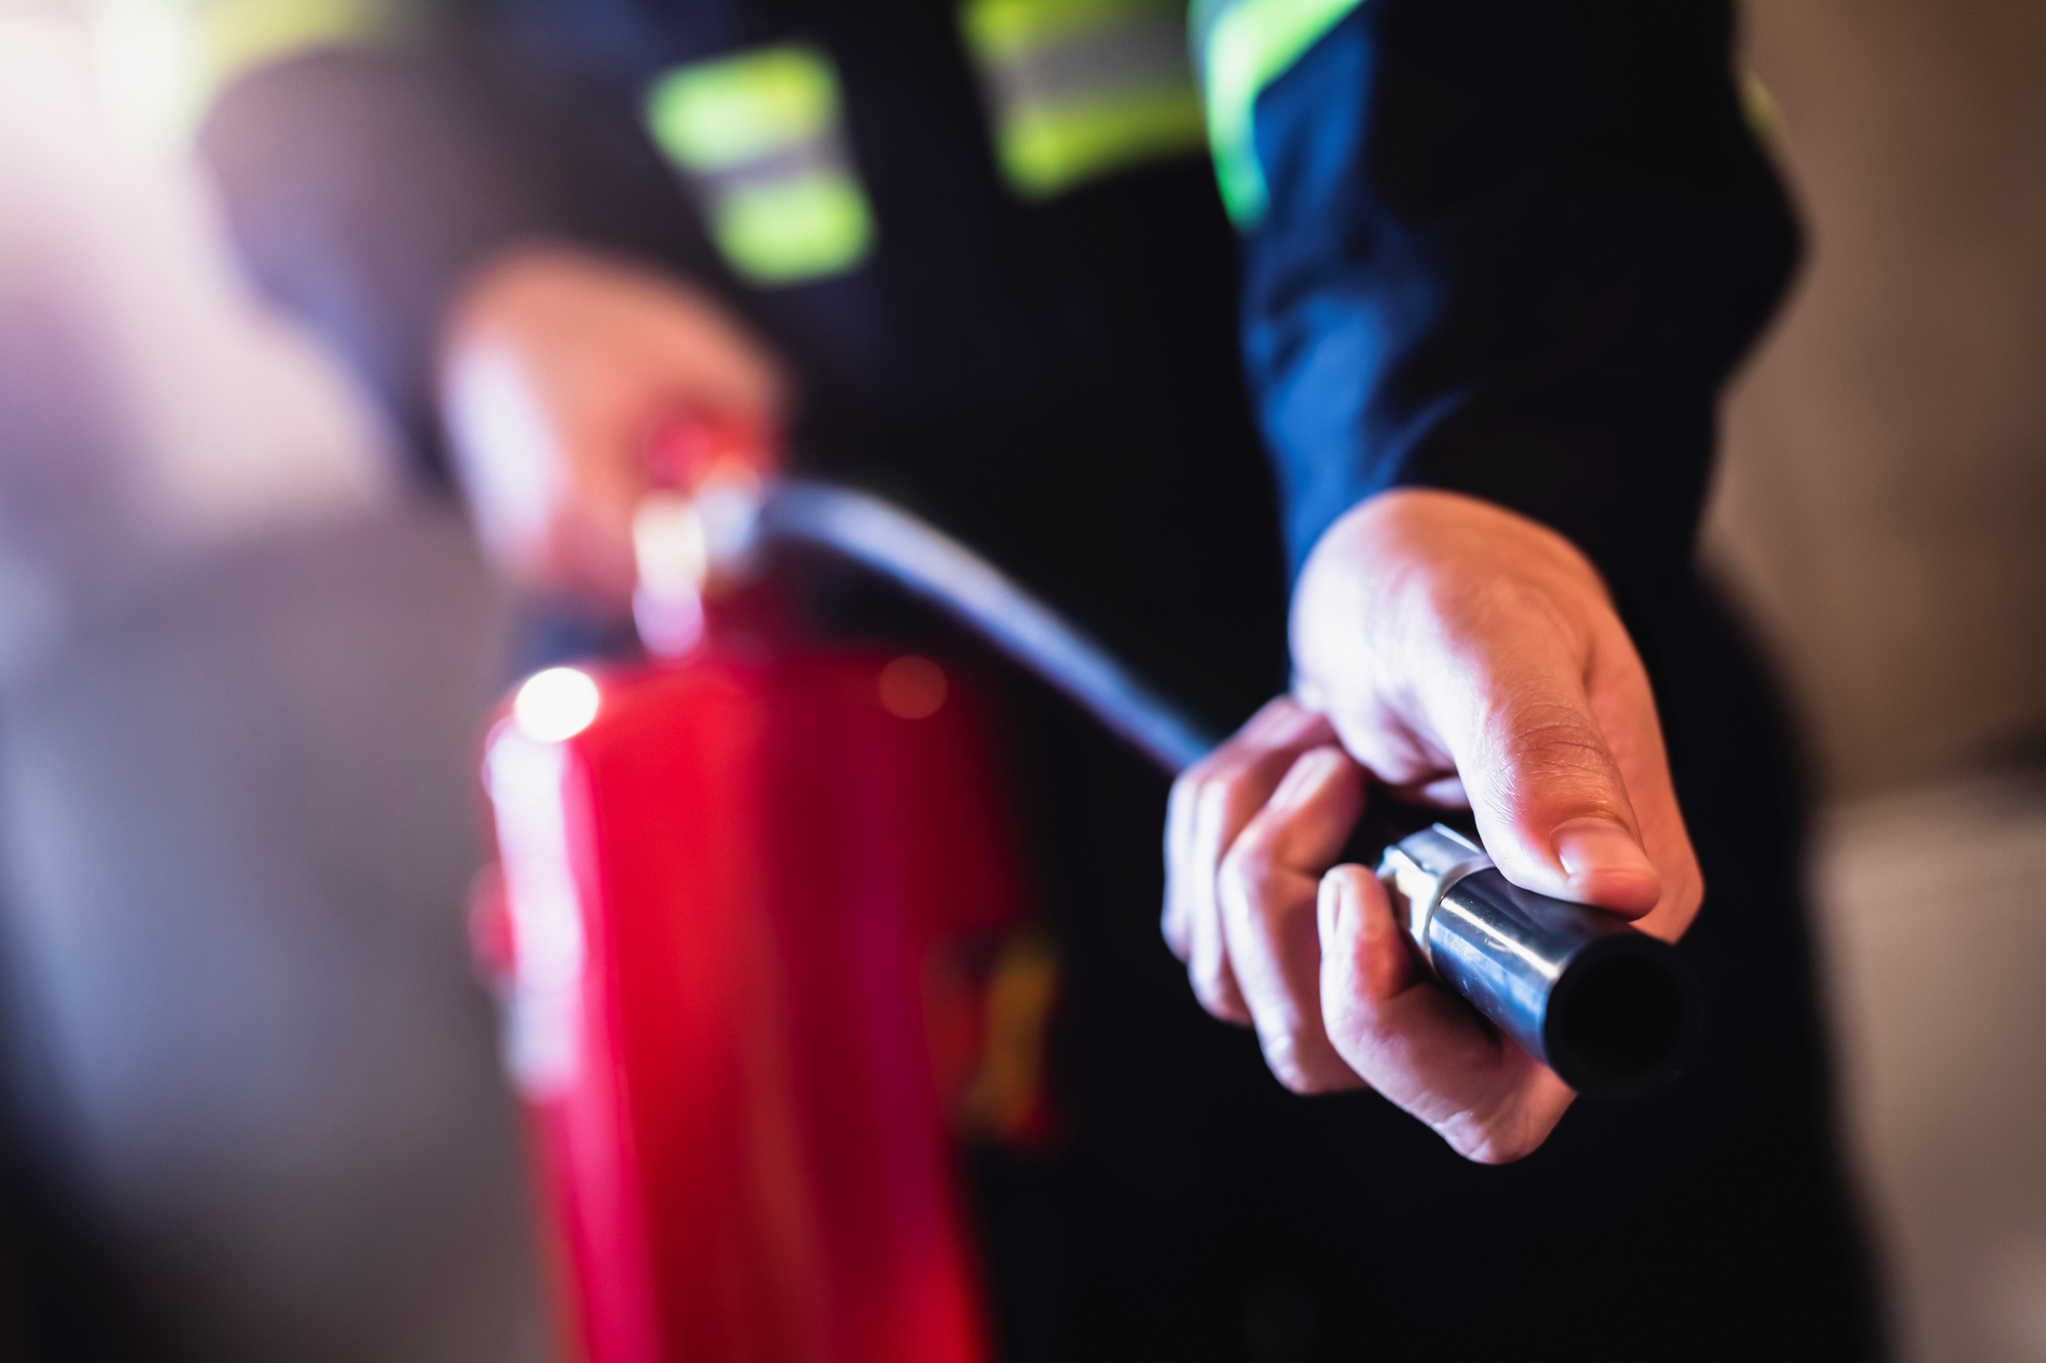
aim
Aim the hose at the base of the fire. Start upwind and approach the fire cautiously.

Slide 8
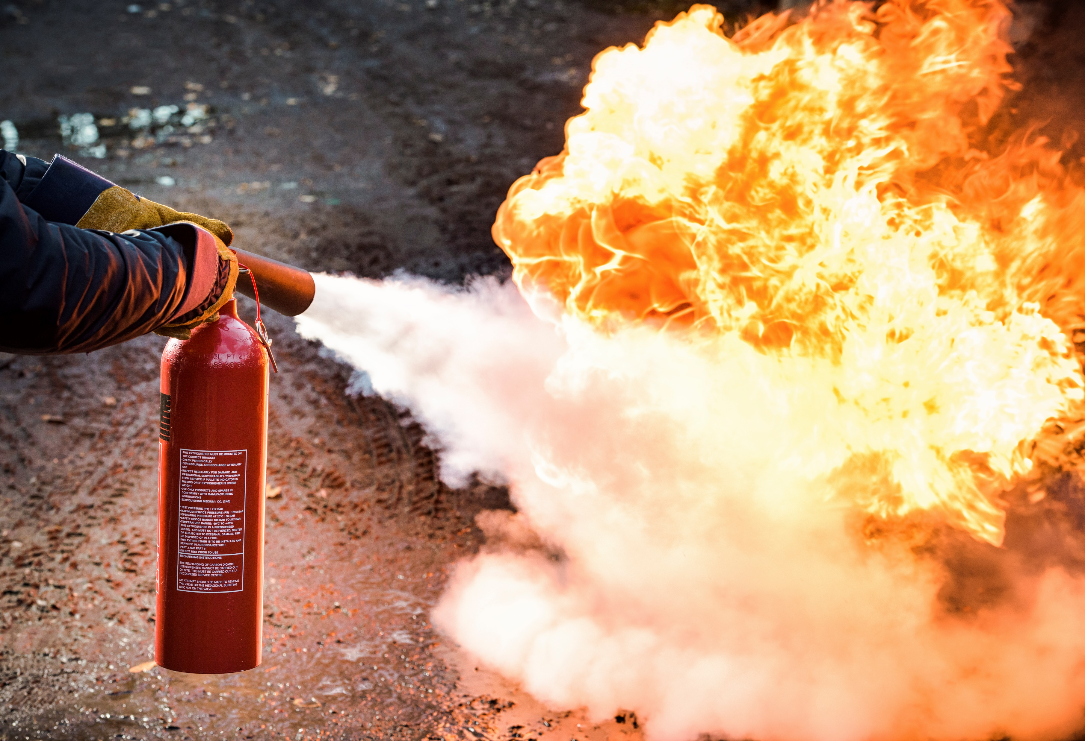
Squeeze and sweep
Squeeze the lever to discharge the extinguisher.
Sweep the spray from side to side.

Slide 9
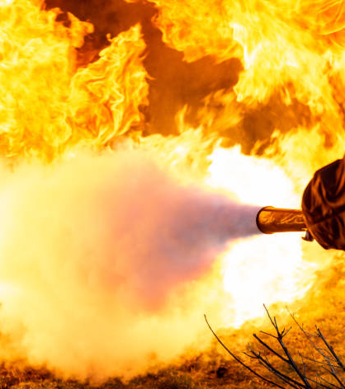
Class a
Wood
Paper
Plastic
Rags

Slide 10
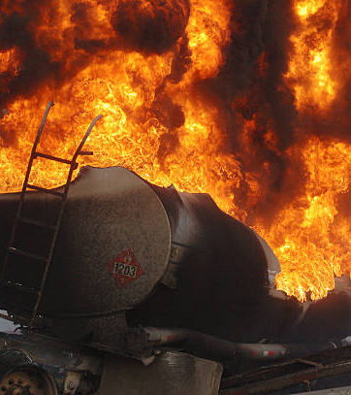
Class b
Gas
Oil
Grease
Paint

Slide 11
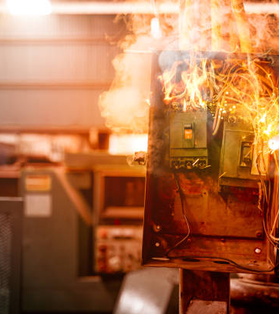
Class C
Electric

Slide 12
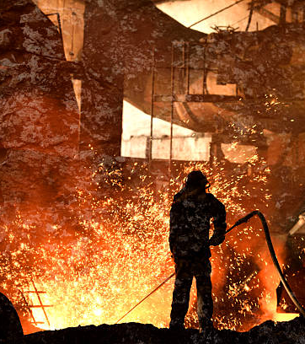
Class D
Metal

Slide 13
A minimum of ____
4A60BC fire
extinguishers should be
readily available
within 10 feet of all
torching activities.
Name one thing you
should do
and
one thing you
should not do
when tending to a
burn victim.
What does the plastic
seal band through the
release pin of a fire
extinguisher ensure?
Name two things that
should be done for
victims of propane
freeze burn.
Name two materials that—
if they were on fire—
would be classified as
Class A fires.
What words does the term
PASS stand for?
What classification of
fire extinguisher should
be within 10 feet of
torch work?
Name three types of PPE
that should be used while
doing torch work.
What should be done with
a fire extinguisher that
has been discharged?

Slide 14
Can you:
1. List personal protective equipment requirements for torching activities?
2. Describe basic first-aid procedures associated with torching activities?
3. Describe the PASS system for using a fire extinguisher?

Slide 15
Pre-job Planning and Preparation
Section 2

Slide 16
During this section you should be able to:
1. Identify the key elements of a comprehensive pre-job inspection
2. Prescribe hazard controls when torching near hazardous areas

Slide 17
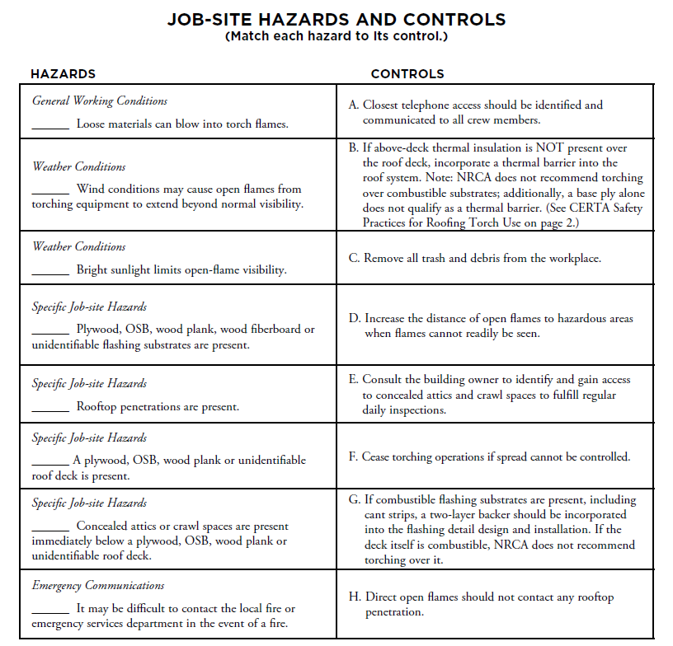

Slide 18
Can you:
1. Identify the key elements of a comprehensive pre-job inspection?
2. Prescribe hazard controls when torching near hazardous areas?

Slide 19
Propane Tool and Equipment Safety
Section 3

Slide 20
During this section you should be able to:
1. Name the components of a roofing torch assembly
2. Explain the proper steps and procedures for handling propane gas cylinders

Slide 21
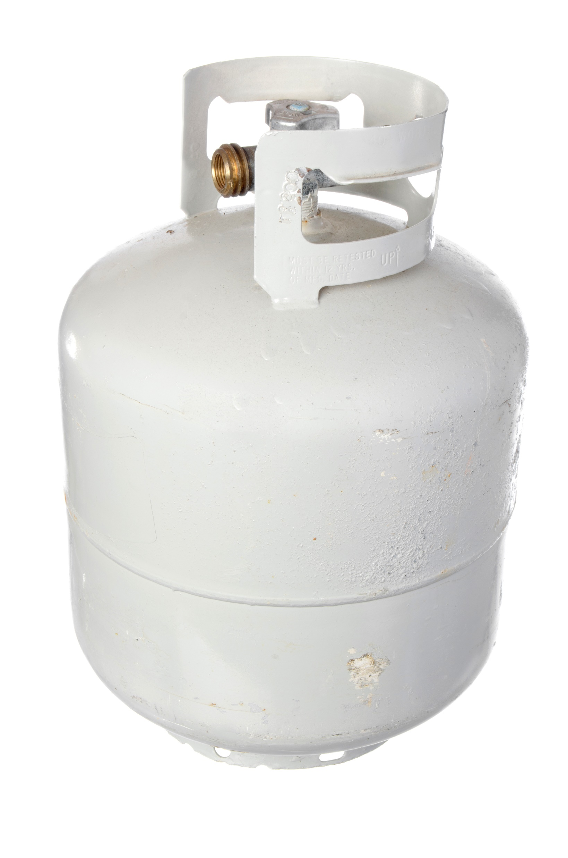
Propane tank

Slide 22
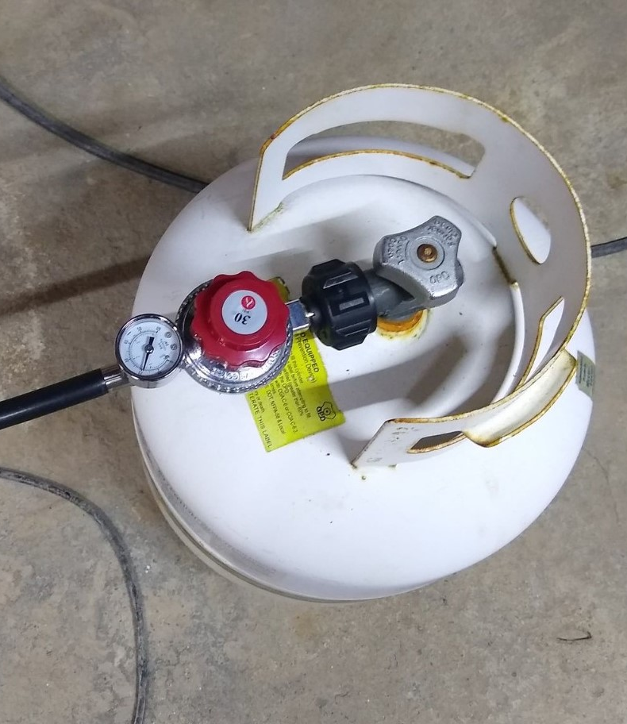
Propane tank
With regulator

Slide 23
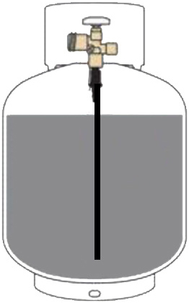
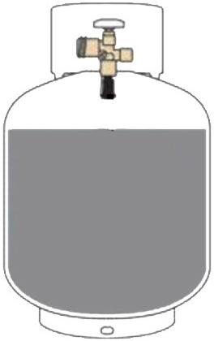
Liquid & vapor withdrawal

Slide 24
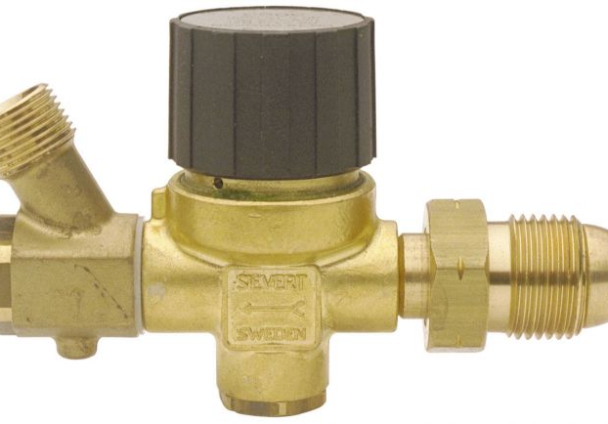

Slide 25
Can you:
1. Name the components of a roofing torch assembly?
2. Explain the proper steps and procedures for handling propane gas cylinders?

Slide 26
application safety
Section 4

Slide 27
During this section you should be able to:
1. Recognize hazardous areas
2. Describe safe torching techniques to use near hazardous areas

Slide 29
Hazard 1

Slide 30
Hazard 2

Slide 31

Hazard 3

Slide 32
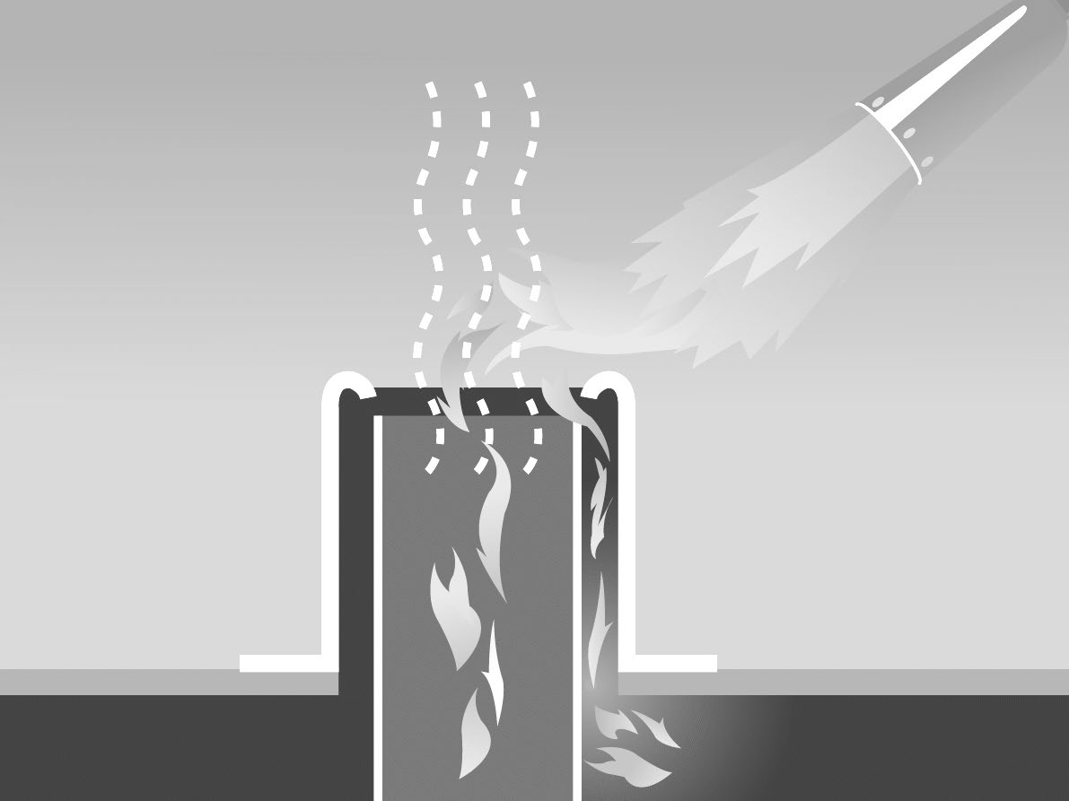
Hazard 4

Slide 33
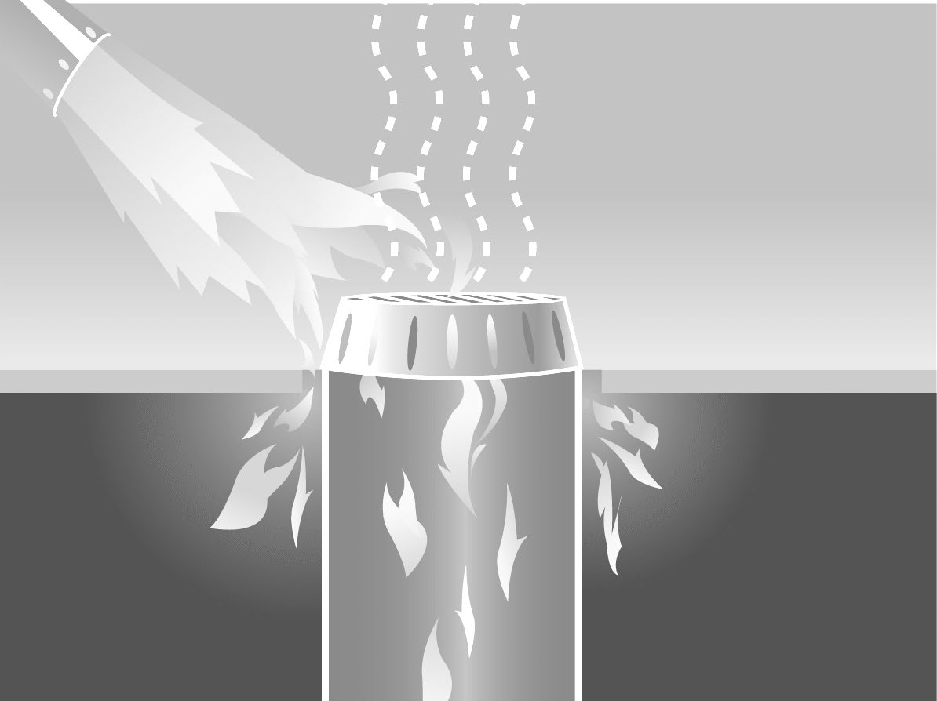
Hazard 5

Slide 34
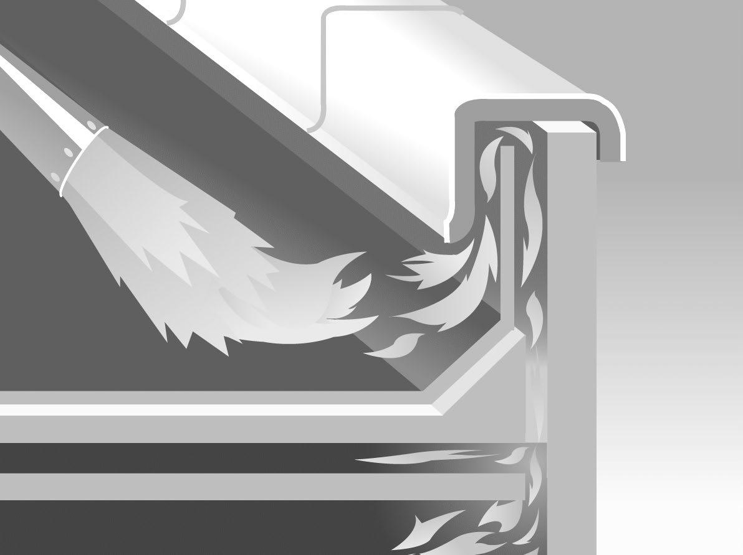
Hazard 6

Slide 35
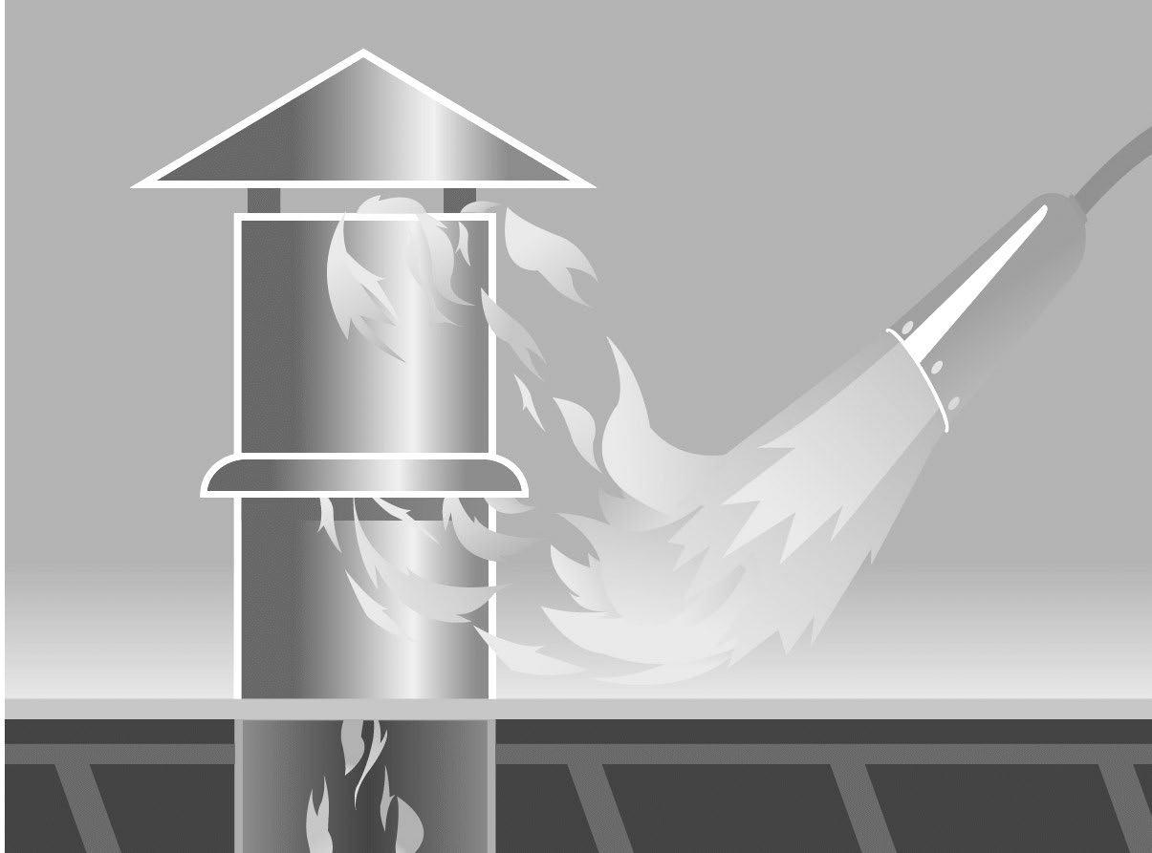
Hazard 7

Slide 36

Hazard 8

Slide 37
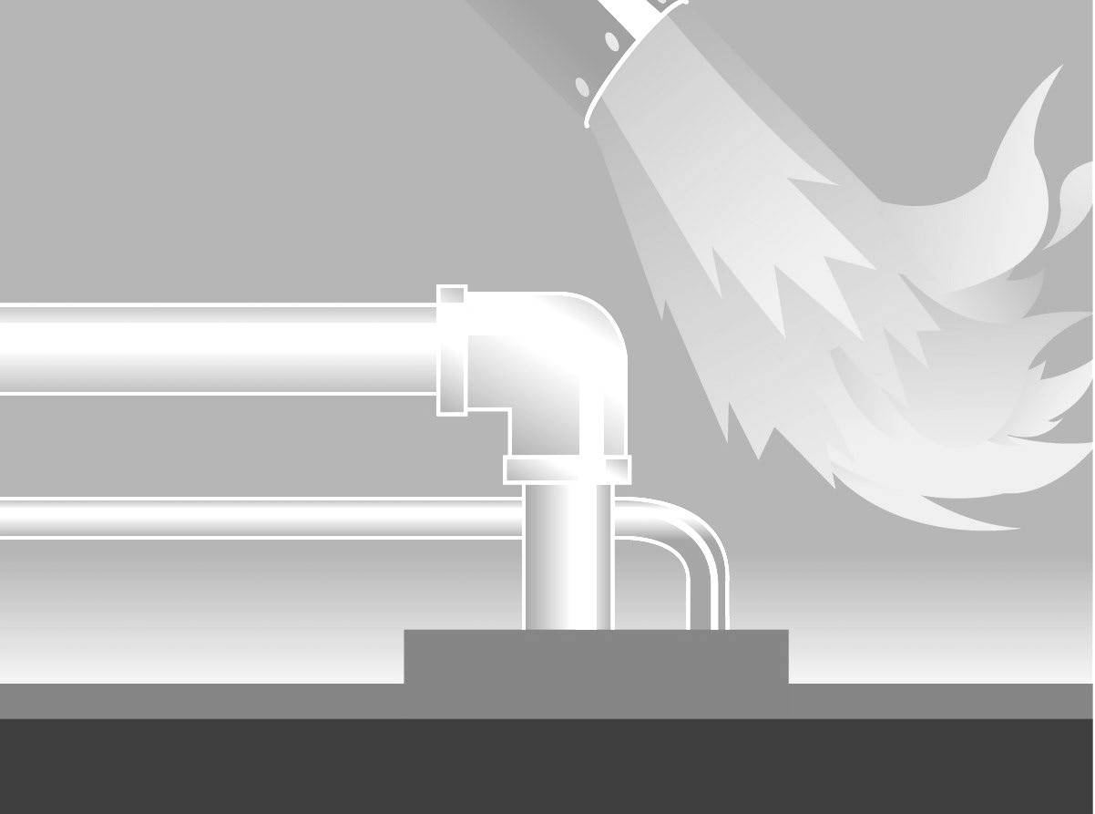
Hazard 9

Slide 38
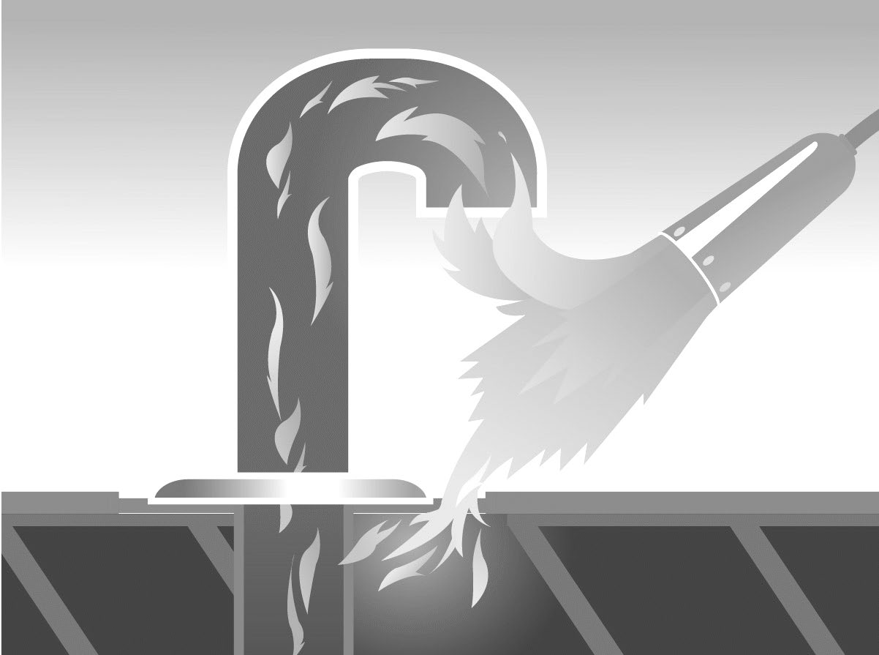
Hazard 10

Slide 39

Hazard 11

Slide 40
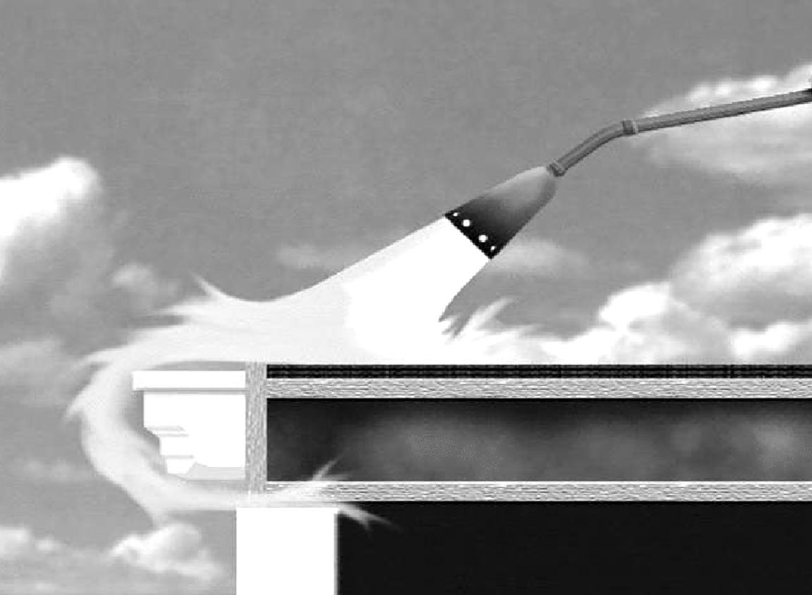
Hazard 12

Slide 41
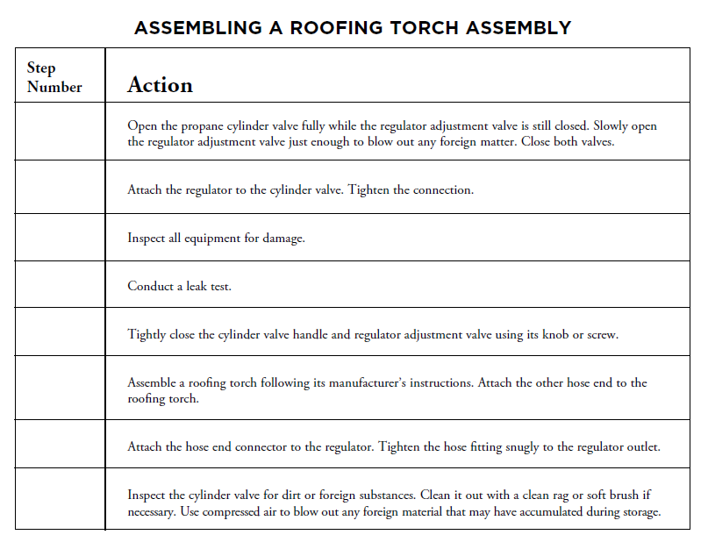

Slide 42
Can you:
1. Recognize hazardous areas?
2. Describe safe torching techniques to use near hazardous areas?

Slide 43
Fire watch requirements and duties
Section 5

Slide 44
During this section you should be able to:
1. Explain the post-job fire watch and other duties

Slide 45
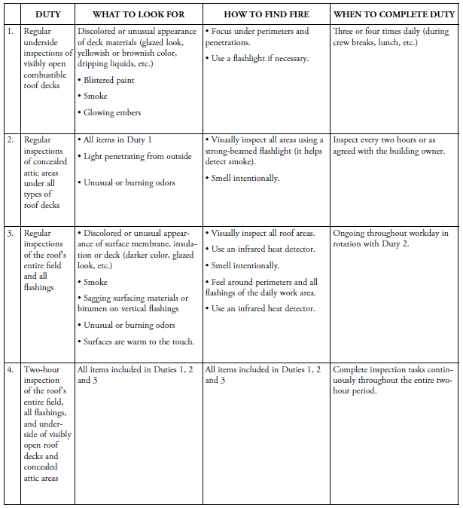

Slide 46
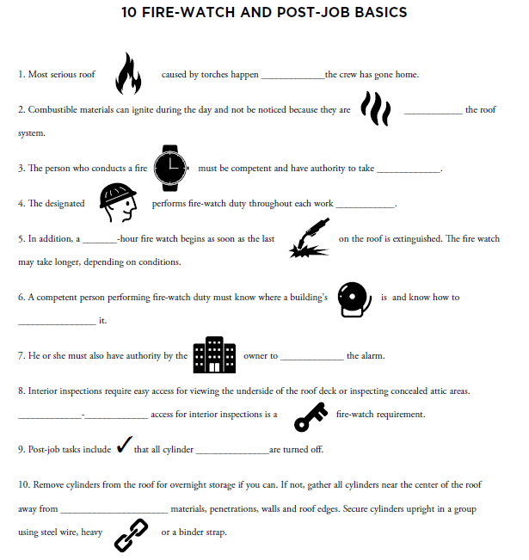

Slide 47
Can you:
1. Explain the post-job fire watch and other duties?

Slide 48
Hands-on torching

Slide 49
During this section you should be able to demonstrate:
1. Proper torch-lighting procedures.
2. Proper torch shut-down procedures.
3. Application of self-adhering base ply with a focus on ensuring sealed laps, using a flashing box mock-up.
4. Flashing torch-and-flop application using a flashing box mock-up.
5. Flashing direct torching application using a flashing box mock-up and a detail application-size (105k Btu or less) torch.
6. Proper starting of field membrane rolls at roof edges or walls.
7. Torch-and-flop method for going around a pipe penetration and a drain.
8. Torch-and-flop method for installing field sheet over a drain penetration.
9. Torch-and-flop method for ending field membranes at roof edges or walls.
10. Ability to evaluate and rate others’ torching behaviors.

Slide 50
exam

Slide 51
CERTA Certification Course

